Slide 1
Deep Learning from Scratch
Theory + Practical
FAHAD HUSSAIN
MCS, MSCS, DAE(CIT)
Computer Science Instructor of well known international Center
Also, Machine Learning and Deep learning Practitioner
For further assistance, code and slide https://fahadhussaincs.blogspot.com/
YouTube Channel : https://www.youtube.com/fahadhussaintutorial

Slide 2
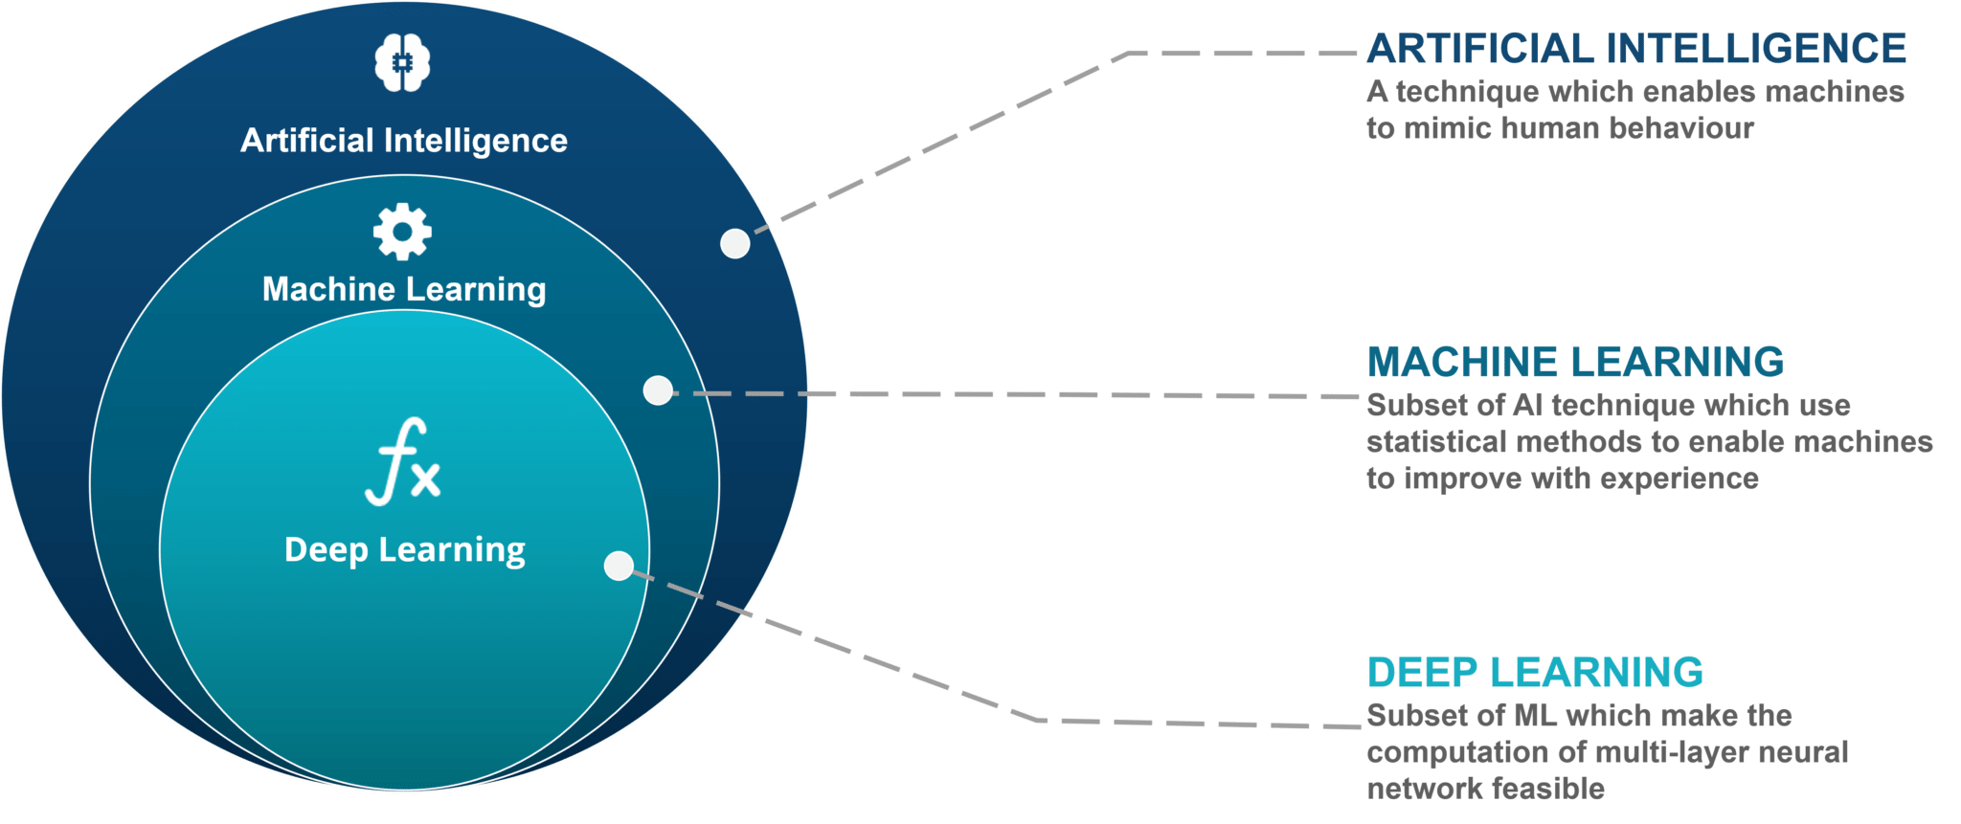
AI vs ML vs DL
For further assistance, code and slide https://fahadhussaincs.blogspot.com/
YouTube Channel : https://www.youtube.com/fahadhussaintutorial

Slide 3
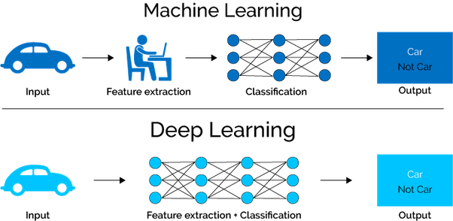
ML vs DL
For further assistance, code and slide https://fahadhussaincs.blogspot.com/
YouTube Channel : https://www.youtube.com/fahadhussaintutorial

Slide 4

So, What do you think, what is Deep Learning
Deep learning is a machine learning technique that learns features and task directly from the data, where data may by images, text or sound!
For further assistance, code and slide https://fahadhussaincs.blogspot.com/
YouTube Channel : https://www.youtube.com/fahadhussaintutorial

Slide 5
So, What we learn in this course
Artificial Neural Network
Convolutional neural network
Recurrent neural network
Boltzmann machine Vs Deep BM
Self organizing maps
Autoencoder
GAN (Generative Adversarial Network)
Deep Q Learning
Pre Train Model (CNN Architecture and many more…
Keras
Vs
TensorFlow
For further assistance, code and slide https://fahadhussaincs.blogspot.com/
YouTube Channel : https://www.youtube.com/fahadhussaintutorial

Slide 6
Thank You!
For further assistance, code and slide https://fahadhussaincs.blogspot.com/
YouTube Channel : https://www.youtube.com/fahadhussaintutorial

